Slide 1
VA Central IRB
Researcher and Study Team Training
Don E. Workman, Ph.D., VA IRB Network Director
Christie O’Brien, VA Central IRB Manager
Lindsey Martin, VA Central IRB Program Specialist
Angela Foster, VAIRRS Program Manager
March 3, 2021
Dial in (Main): (404) 397-1596
Attendee Access Code: 199-219-1720
Slides available on SharePoint:
See link in Q&A Box

Slide 2
Topics
  CIRB SharePoint Site
  What is VAIRRS?
  Accessing and Registering in IRBNet
  User Profile
  My Projects
  CIRB Submission Process
  Viewing review results
  Returned Packages
  Subsequent Packages

Slide 3
What happens to SharePoint?
The CIRB SharePoint portal will be not accept new submissions after March 12th at 8 PM EST
  Reportable Events that need to be submitted between Friday, 8PM and Monday, 8PM, should be submitted to the Central IRB mailbox at VACentralIRB@va.gov.
SharePoint will remain for meeting minutes and as a reference/document storage until study documents are transferred to IRBNet
  Priority for study document upload will be given to pending actions and studies with an upcoming (on or before April 15th) continuing review/annual status report due date
  Documents for all other studies will be uploaded over the next three months
  Study Teams must register in IRBNet before March 12th
All new actions must be submitted via IRBNet
  All new PI/SC and LSI study applications must be routed through the local research administration
    Researchers affiliated with sites not yet live may submit directly to CIRB
  All post-approval actions may be submitted directly to the CIRB

Slide 4

Important Planned SOP Changes
The CIRB SharePoint portal will be not accept new submissions after March 12th at 8 PM EST
Study Teams must register in IRBNet before March 12th
All new PI/SC and LSI study applications must be routed through the local research administration
  Researchers affiliated with sites not yet live may submit directly to CIRB
All post-approval actions may be submitted directly to the CIRB

Slide 5
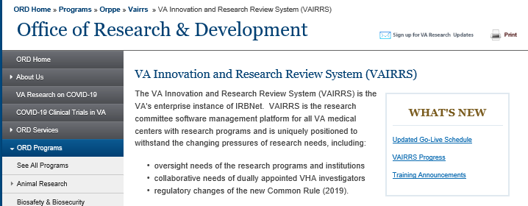
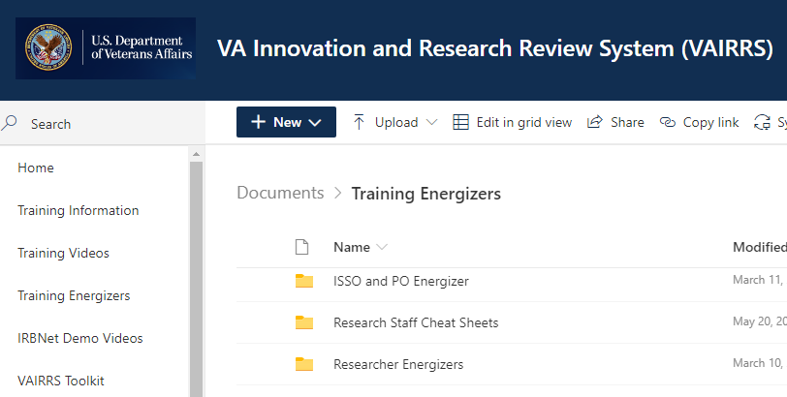
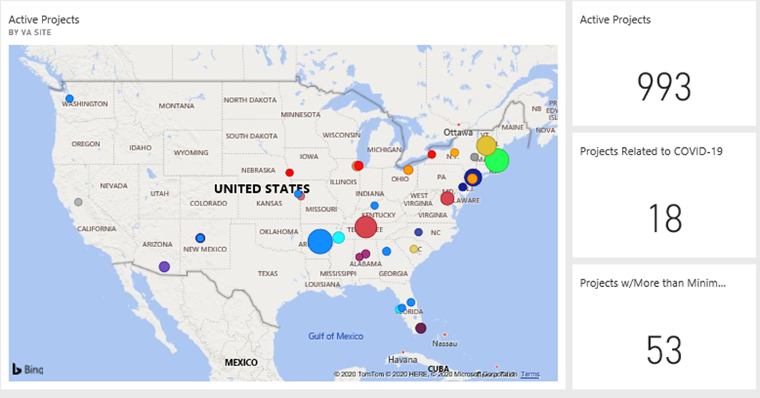
What is VAIRRS?
VA Innovation Research and Review System
  IRBNet
  VAIRRS Website: https://www.research.va.gov/programs/orppe/vairrs/default.cfm
  VAIRRS SharePoint Portal: https://dvagov.sharepoint.com/sites/VHAORPPE/vairrs
  PowerBI Dashboards

Slide 6
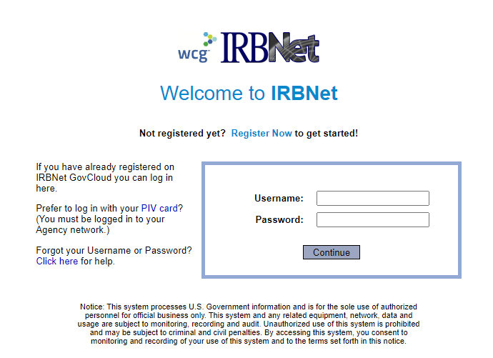
Accessing IRBNet
Website address: gov.irbnet.org
  PIV Login
  Accessible from outside the VA network

Slide 7
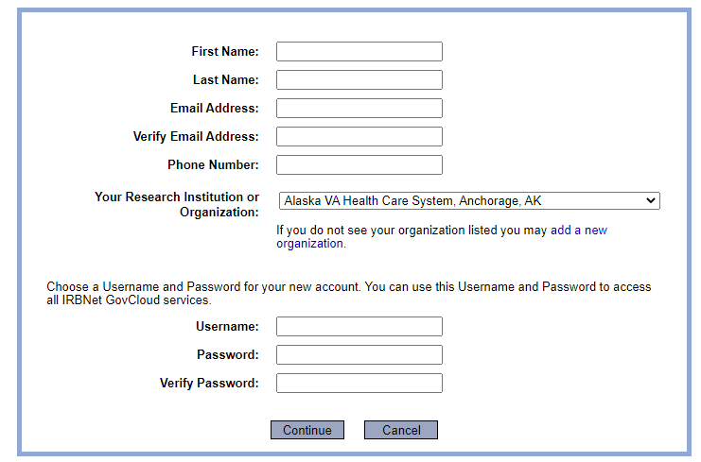
Enrolling in IRBNet
All VA facilities are listed in affiliation section

Slide 8
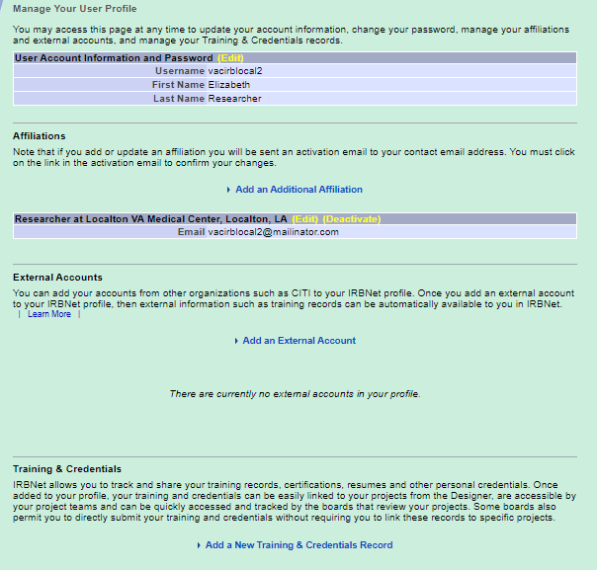

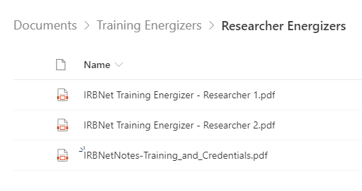
User Profile
Add additional affiliations
VAIRRS SharePoint –
Training and Credential
Training Energizer

Slide 9
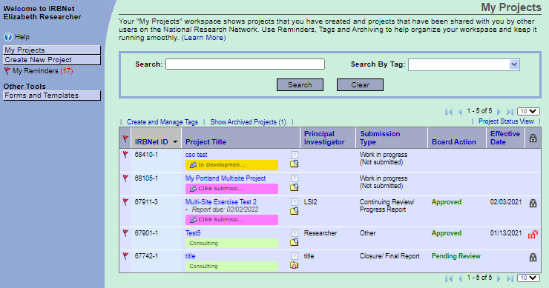
My Projects - Tags
Use Tags to organize your workspace

Slide 10
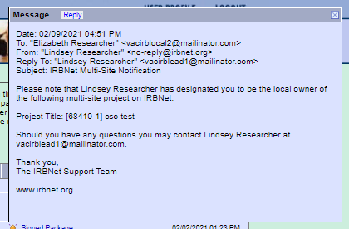

My Projects - Reminders
Reminders!

Slide 11
My Projects – Search Options
Search and Filter

Slide 12
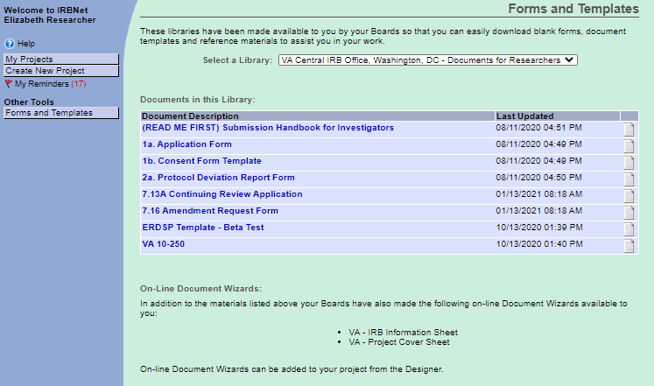
My Projects – Forms and Templates
Select the correct library!
Electronic Wizards

Slide 13
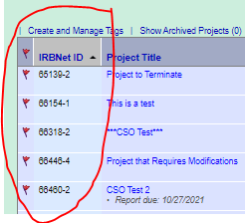
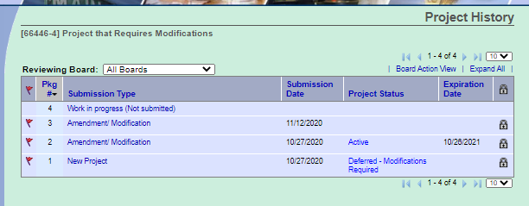
Project vs Package
Approved Project
(Package -1)
CR/Progress Report
(Package -3)
Amendment
(Package -4)
Amendment
(Package -2)
Unique
Identifier
Subsequent
Packages

Slide 14

Polls
Have you registered for an IRBNet account yet?
  Yes
  No
If you have registered, are you actively using IRBNet?
  Not using at all
  Using at least once a month
  Using at least once a week
  Using daily

Slide 15
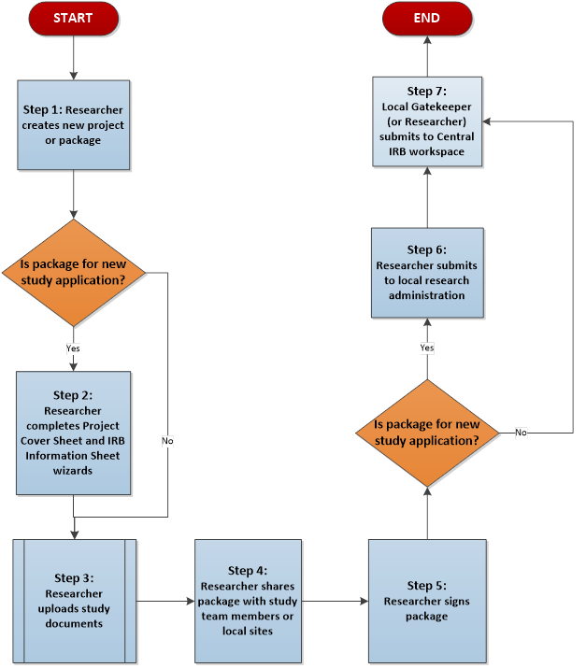
*Planned CIRB Submission Process
*The proposed routing is subject to continued conversations with VA CIRB stakeholders.

Slide 16
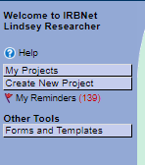
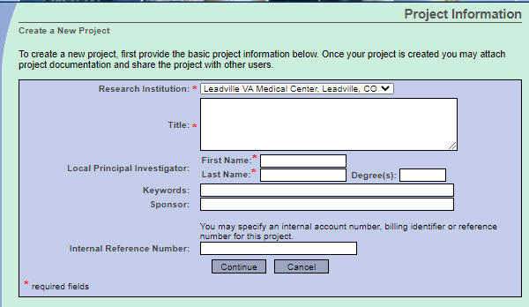
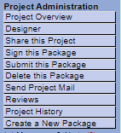
Creating a Project
Step 1: Select Create New Project or Create a new Package
Step 1
-OR-
Step 1

Slide 17
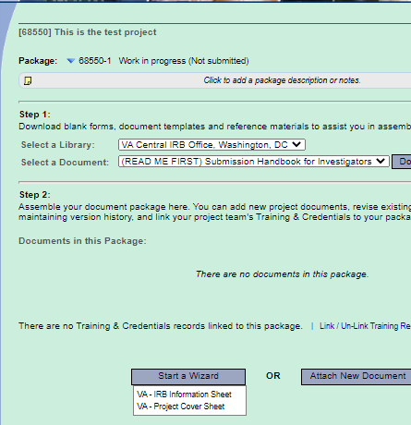
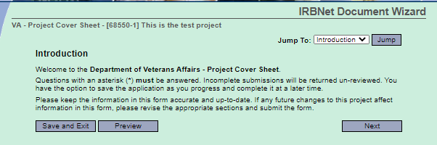
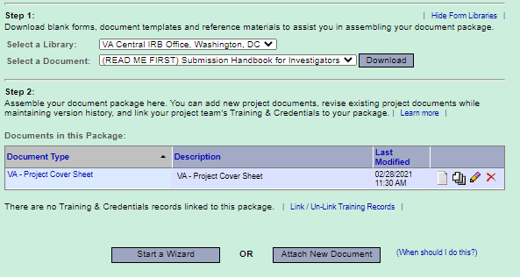
Creating a Project
Step 2: Complete electronic wizards
Step 2

Slide 18
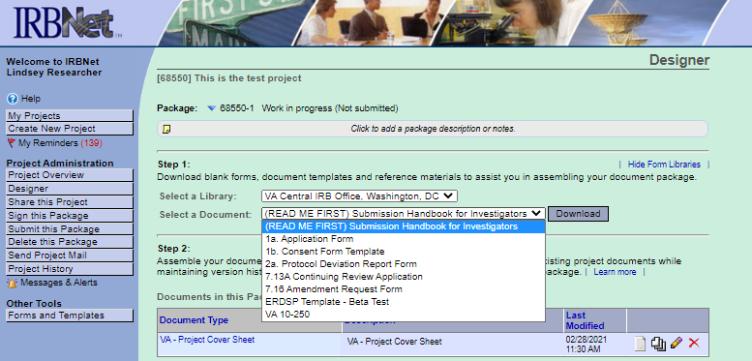
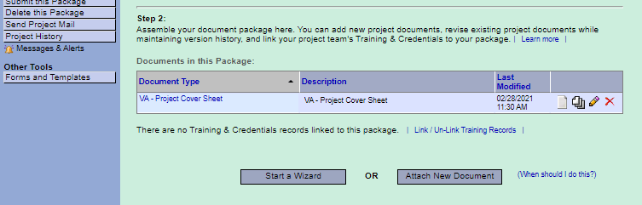
Creating a Project
Step 3: Upload Study Documents
Step 3

Slide 19
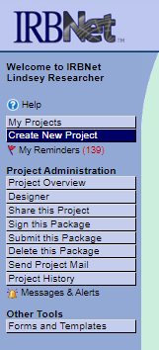
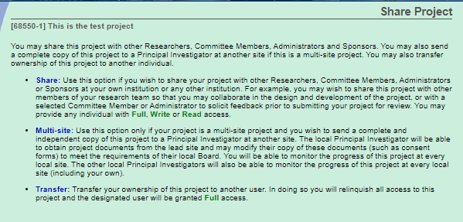
Creating a Project
Step 4: Share Package
Step 4

Slide 20
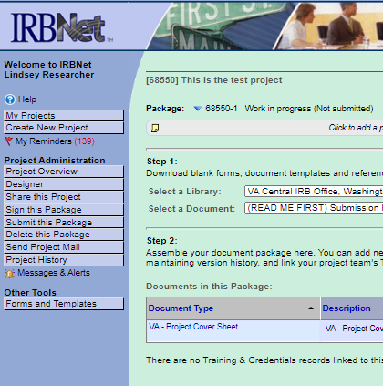
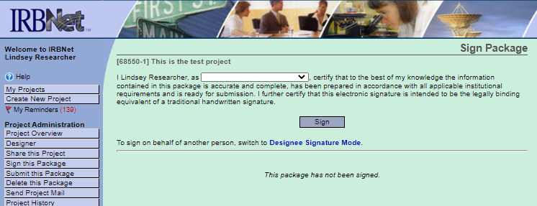
Creating a Project
Step 5: Sign Package
Step 5

Slide 21
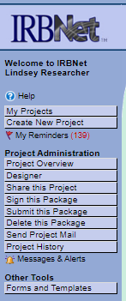
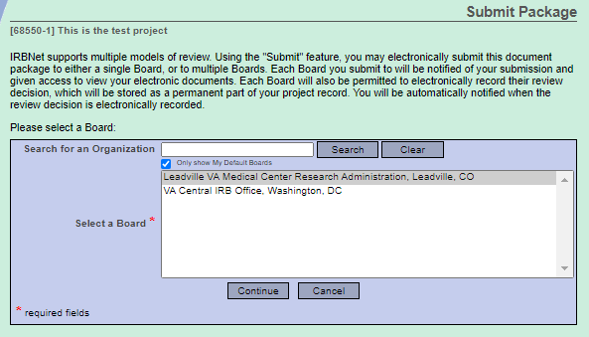
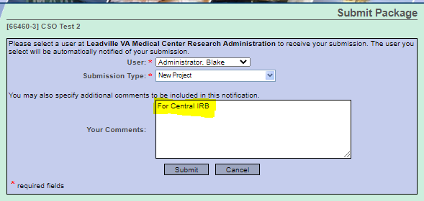
Creating a Project
Step 6: Submit Package
Step 6

Slide 22
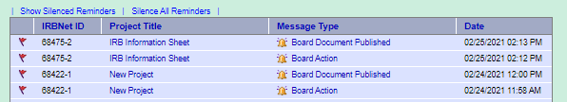
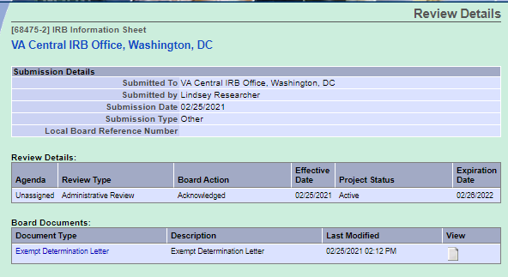
Review Results
Viewing review results

Slide 23
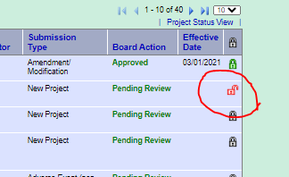
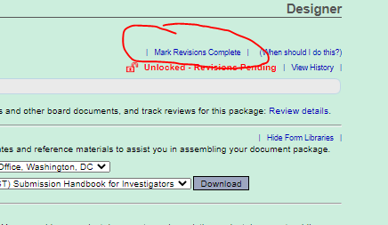
Returned Packages
All packages are ‘locked’ upon submission
Packages may be ‘unlocked’ and returned prior to board review if required forms are missing
Follow document upload instructions to add missing documents to package
Mark Revisions Complete

Slide 24
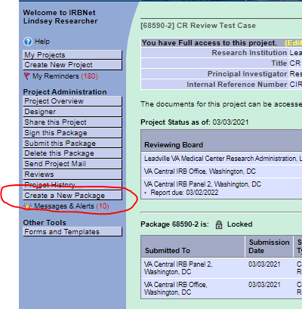
Subsequent Packages
Select ‘Create a New Package’
Upload study documents
Sign Package
Submit Package

Slide 25

In Summary …
The CIRB SharePoint portal will be not accept new submissions after March 12th at 8 PM EST
Study Teams must register in IRBNet before March 12th
All new PI/SC and LSI study applications must be routed through the local research administration
  Researchers affiliated with sites not yet live may submit directly to CIRB
All post-approval actions may be submitted directly to the CIRB

Slide 26
Additional Guidance
All guidance documents will be posted in the Forms and Templates library
VAIRRS SharePoint Portal: https://dvagov.sharepoint.com/sites/VHAORPPE/VAIRRS
VAIRRS Website: https://www.research.va.gov/programs/orppe/vairrs/default.cfm
For questions regarding local submission procedures:
  Contact your local research office
For questions related to CIRB processes:
  Contact the IRB Manager
For questions related to the VAIRRS program:
  Contact Angela Foster at angela.foster@va.gov or VAIRRS@va.gov
For technical issues with IRBNet:
  Contact IRBNet Support at govsupport@irbnet.org

Slide 27
IRBNet Terms
Institution/Organization – Each VAMC and the Central IRB are considered ‘Organizations’ in IRBNet.
Workspace – Each Board or Panel at an Institution has a logical ‘workspace’ to manage submissions to that panel and conduct reviews
Package – Package and submission are used interchangeably. A package represents the individual submissions (Initial Review, CR, Amendments, etc.) for a project.
Submission Manager – The Submission Manager is the primary user interface for all user roles. The submissions viewable in your Submission Manager are dependent on your role, permission level, shared submissions, and selected (manual or default) filters.
IRBNet ID – The IRBNet ID is the unique identifier for every Project and Package. The numbers before the dash represent the Project and the number after the dash represent the package.

Slide 28
VAIRRS Go Live Schedule

Slide 29

Thank You for Attending!

Slide 30
Questions?

Slide 31
Availability of Recording
A recording of this session and the associated handouts will be available on ORPP&E’s Education and Training website approximately one-week post-webinar
An archive of all ORPP&E-hosted webinars can be found here: https://www.research.va.gov/programs/orppe/education/webinars/archives.cfm

